Slide 1
Chapter 3 Scanning – Theory and Practice

Slide 2
Overview of scanner
A scanner transforms a character stream of source file into a token stream.
It is also called a lexical analyzer.
Formal definitions allow a language designer to anticipate design flaws such as:
Virtually all languages specify certain kinds of rational constants. Such constants are often specified using decimal numerals such as 0.1 and 10.01.
Can .1 or 10. be allowed? C, C++, Java say YES
But, Pascal and Ada say NO
Why? 1..10 (range 1 to 10) would have been recognized as
1. and .10 two contants.

Slide 3
What is a token anyway?
character stream
honeycone=5+10*num ;
token stream
ID ‘=‘ INT ‘+’ INT ‘*’ ID ‘;’
A sample token data structure
struct token {
int type ; // ID, INT, …..
int ival ; // integer value of a token
string name ; // store the token string
}

Slide 4
Scanner.l
%{
#include “y.tab.h”
%}
asgdada { yylval.ival = 5 ;

Slide 5
Regular expression
Regular expression is a convenient way to specify various sets of strings and it can specify the structure of the tokens used in a programming language.
A set of strings defined by a regular expression is called a regular set.

Slide 6
Regular expression (Cont.)
The definition of regular expression starts with a finite character set, or vocabulary (denoted Σ)
An empty (null) string is allowed (denoted λ). It represents an empty buffer in which no characters have yet been matched.

Slide 7
Regular expression (Cont.)
Strings are built from characters in the character set Σ via catenation.
As characters are catenated to a string, it grows in length.
For example, the string do is built by first catenating d to λ and then catenating o to the string d.
The null string λ, when catenated with any string s, yields s. That is, sλ ≡ λs ≡ s.

Slide 8
Regular expression (Cont.)
A meta-character is any punctuation character or regular expression operator.
The following six symbols are meta-characters:
( ) ’ * + |
The expression ( ‘(‘ | ’)’ | ; | , ) defines four
single-character tokens:
(left parenthesis, right parenthesis,
semicolon, and comma).

Slide 9
Regular expression (Cont.)
Alternation “|” can be extended to sets of strings.
Let P and Q be sets of strings. Then strings
s (P|Q) if, and only if, s P or s Q.
The operation, Kleene closure, is defined as:
The operator * is the postfix Kleene closure operator.
For example, let P be a set of strings. Then P* represents all strings formed by the catenation of zero or more selections from P.

Slide 10
Regular expression (Cont.)
- 0 is a regular expression denoting the empty set (the set containing no strings).
λ is a regular expression denoting the set that contains only the empty string.
s is a regular expression denoting {s}: a set containing the single symbol s Σ
If A and B are regular expressions,
then A | B, AB, and A* are also regular expressions.
They denote 3 operators:
1) alternation, 2) catenation, and 3) Kleene closure
of the corresponding regular sets.

Slide 11
Regular expression (Cont.)
The following are additional operators:
P+, sometimes called positive closure, denotes all strings consisting of one or more strings in P catenated together: P*= (P+ | λ) and P+ = PP*.
If A is a set of characters, Not(A) denotes (Σ - A), that is, all characters in Σ , but not in A.
If k is a constant, then the set A^{k} represents all strings formed by catenating k (possibly different) strings from A.

Slide 12
Regular expression (Cont.)
A basic pattern (such as “b”) can optionally be followed by repetition operators:
b? for an optional b;
b* for a possibly empty sequence of b;
b+ for a non-empty sequence of b.
There are two composition operators:
catenation and alternatives:
ab b follows a
ab* | cd? ab* or cd?

Slide 13
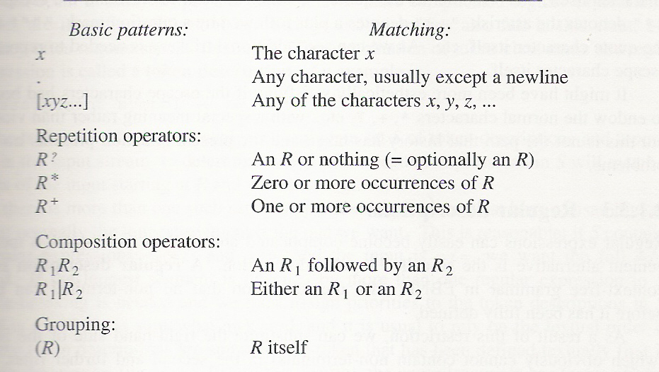
Patterns of Regular Expression

Slide 14
Regular expression (Cont.)
Examples:
(a|b)(a|b) will generate aa|ab|ba|bb
ab* will generate a|ab|abb…
(ab)* will generate λ | ab | abab|ababab…

Slide 15
The regular expression for “identifier” is:
letter → [a-z A-Z]
digit → [0-9]
underscore → _
letter_or_digit → letter | digit
underscored_tail →
underscore letter_or_digit+
identifier → letter letter_or_digit*
underscored_tail*

Slide 16
More Regular Expression Examples
^(19|20)\d\d[- /.](0[1-9]|1[012])[- /.](0[1-9]|[12][0-9]|3[01])$
matches a date in yyyy-mm-dd format from between 1900-01- 01 and 2099-12-31, with a choice of four separators.
#.*$
matches a single-line comment starting with a # and continuing until the end of the line.
"[^"\r\n]*"
matches a single-line string that does not allow the quote character to appear inside the string.
^.*John.*$.
identify the whole line that contains “John” keyword.

Slide 17
The Applications of Regular Expression
Regular expression is widely adopt in many libraries or programming language for you to parse strings
C standard library
C++ reg
Boost.regex
Php, python, perl…. Many many more
Unix tools : sed awk lex…
It can be very handy when you need to check strings like IP address, html tags….

Slide 18
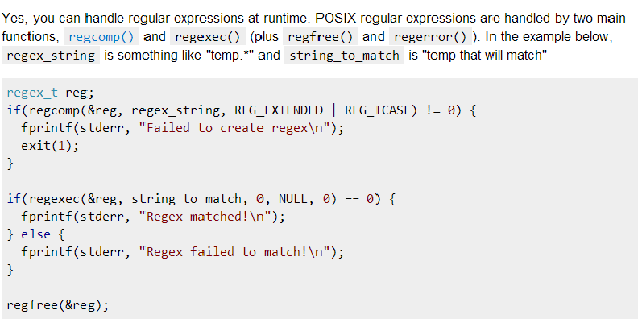
C standard library (long long time ago)

Slide 19
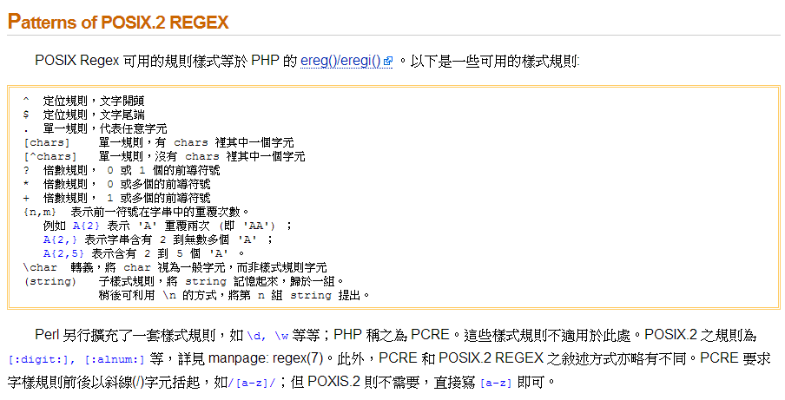
Regex in Posix

Slide 20

Lex
The most well-know scanner for compiler lexical analysis front-end.
you need to return in every matched regular expression so yylex() will return one token at a time (otherwise, a yylex() will read the inputs until the end)
often you need to define a token data structure and store the tokens elsewhere
However, you can also use it for other general goals
ex. formatting log files into the one you need.
ex. file format translator
ex. preprocessing input data
…..

Slide 21


Slide 22

Given a set of regular expressions, how can we build a recognizer (scanner) for it?

Slide 23
Finite Automata and Scanners
A finite automation (FA) can be used to recognize the tokens specified by a regular expression.
An FA consists of:
A finite set of states
A finite vocabulary, denoted Σ
A set of transitions (or moves) from one state to another, labeled with characters in Σ
A special state called the start state
A subset of the states called the accepting, or final, states.
An FA can also be represented graphically using a transition diagram, composed of the components shown in Fig. 3.1.

Slide 24
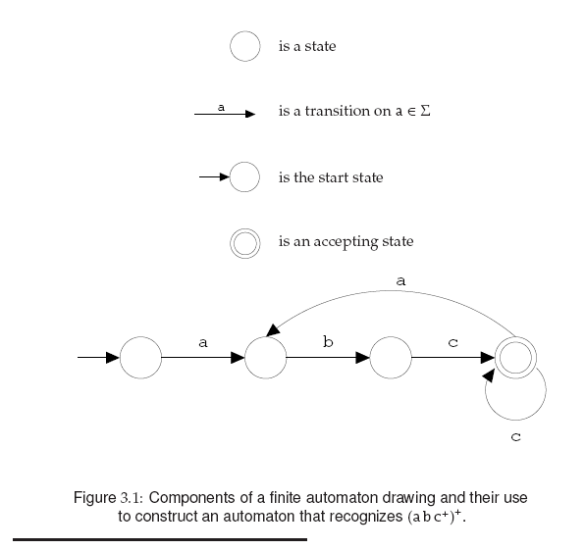
Finite Automata and Scanners (Cont.)

Slide 25
Finite Automata and Scanners (Cont.)
Deterministic Finite Automata (DFA):
An FA that always allows a unique transition for a given state and character.
DFAs are simple to program and are often used to drive a scanner.
A DFA is conveniently represented in a computer by a transition table.
For example, the regular expression
// (Not (eol) )* eol
which defines a Java or C++ single-line comment, might be recognized by the DFA shown in Fig. 3.2

Slide 26
Finite Automata and Scanners (Cont.)

Slide 27
Finite Automata and Scanners (Cont.)
A DFA can be coded in one of two forms:
Table-driven
Explicit control
In the table-driven form,
the transition table that defines a DFA’s actions is explicitly represented in a runtime table
that is “interpreted” by a driver program (figure 3.3).
Notably, end-of-file is represented by “eof”.

Slide 28
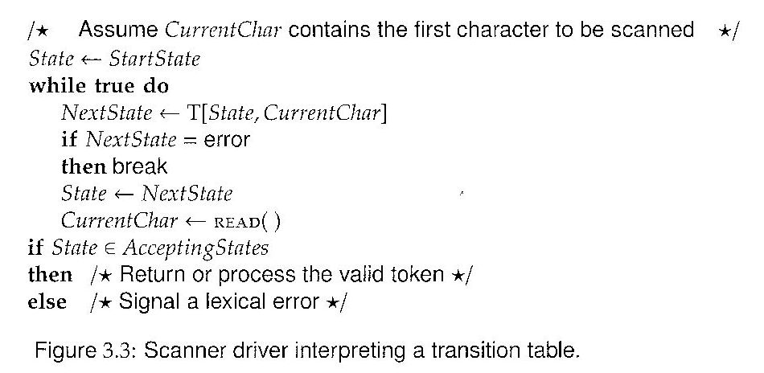
Finite Automata and Scanners (Cont.)

Slide 29
Finite Automata and Scanners (Cont.)
In the explicit control form,
the transition table that defines
a DFA’s actions appears
implicitly as the control logic
of the program as shown in figure 3.4.

Slide 30
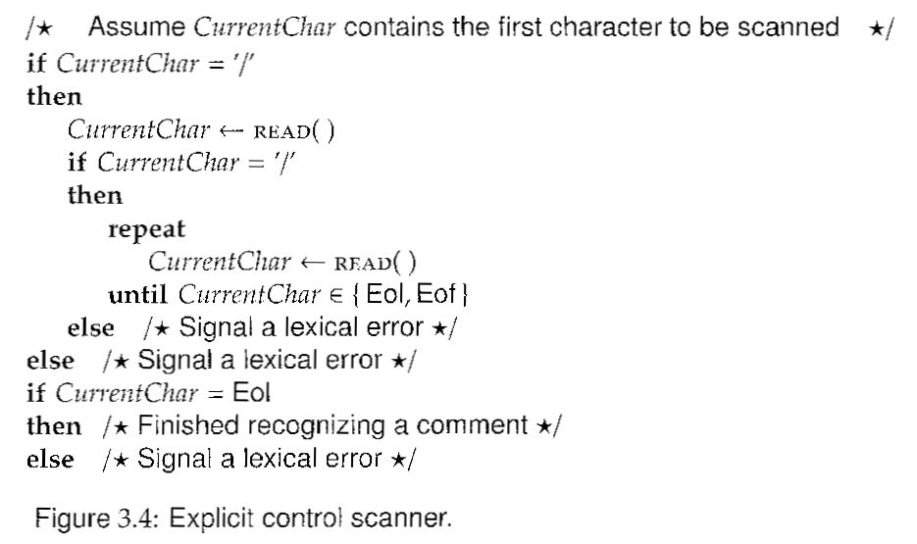
Finite Automata and Scanners (Cont.)

Slide 31
Finite Automata and Scanners (Cont.)
An FA that analyzes or transforms its input beyond simply accepting tokens is called transducer.
The FAs shown in Fig. 3.5 recognize a particular kind of constant and identifier.
A transducer that recognizes constants might be responsible for developing the appropriate bit pattern to represent the constant.
A transducer that processes identifiers may only have to retain the name of the identifier.

Slide 32
Finite Automata and Scanners (Cont.)

Slide 33
Regular Expressions and Finite Automata
Regular expressions are equivalent to FAs.
The main job of scanner is to transform
a regular expression into
an equivalent FA.
First, transforming the regular expression into a
nondeterministic finite automaton (NFA).

Slide 34
Regular Expressions and Finite Automata (Cont.)
An NFA is a generalization of a DFA that allows
1) multiple transitions from a state
that have the same label
as well as
2) transitions labeled with λ
as shown in Figs. 3.17 and 3.18, respectively.

Slide 35
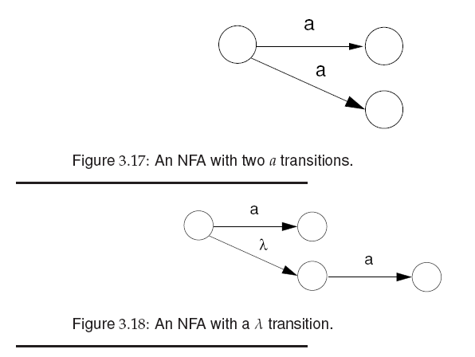
Regular Expressions and Finite Automata (Cont.)

Slide 36

NFA DFA

Slide 37
Transforming Regular Expression to NFA
A regular expression is built of:
the atomic regular expressions:
a (a character in Σ) and λ (see Fig. 3.19)
using the three operations:
AB, A|B, and A* (see Figs. 3.20, 3.21, 3.22)

Slide 38
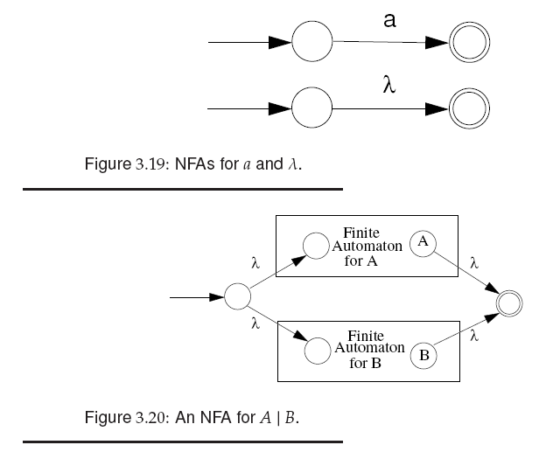
Transforming Regular Expression to NFA (Cont.)

Slide 39
Transforming Regular Expression to NFA (Cont.)
λ

Slide 40
Transforming Regular Expression to NFA (Cont.)
For regular expression (a|b)*abb
First, we create the NFA for a, b, a|b, (a|b)*
Then, we create NFA for “abb”
See the animation next.

Slide 41

0
a
1
λ
λ
a
6
b
7
b
8
4
5
λ
λ
2
b
3

Slide 42
Transforming NFA to DFA
The transformation from an NFA N to an equivalent DFA D works by the subset construction algorithm shown in Fig. 3.23.
We construct each state of D with a subset of states of N. D will be in the state {x,y,z} after reading a given input character, if and only if N could be in any of the states x,y,or z.

Slide 43
Transforming NFA to DFA

Slide 44
Creating the DFA (Cont.)
Assume an NFA N shown in fig 3.24.
Start with state 1, the start state of N, and add its λ closure: state 2. Hence, D’s start state is {1,2}.
Under a, {1,2}’s successor is {3, 4, 5}.
Under b, {1,2}’s successor is itself.
Under a and b, {3,4,5}’s successors are:
{5} and {4,5}, respectively.
Under b, {4,5}’s successor is {5}.
Accepting states of D are those that contain N’s accepting state 5. They are:
{3,4,5} {4,5} and {5} The resulting DFA is shown in fig 3.25.

Slide 45
Notion
N: NFA (non-deterministic finite automata)
D: DFA (deterministic finite automata)
s→t: In N under char c, state s transits to t.
S→T:In D under char c,state S transits to T.
S is a subset of {s | s in N}
c
c

Slide 46
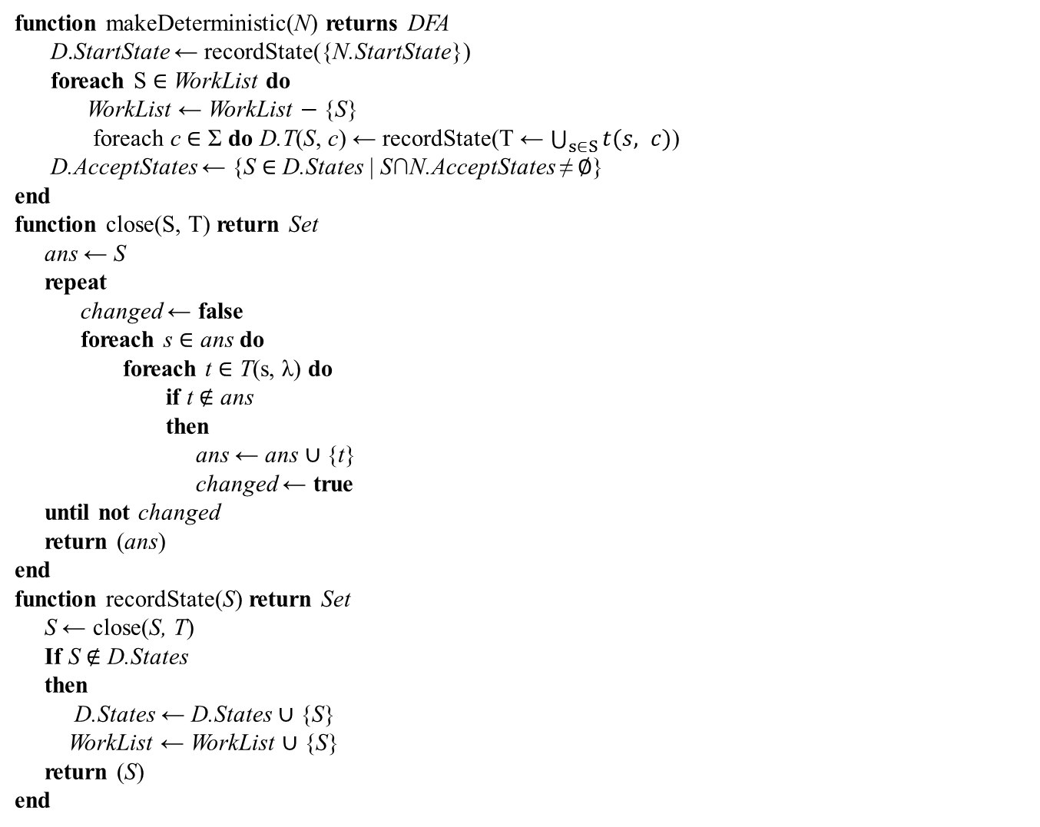
1
2
3
4
5
6
7
8
9
Revised Figure 3.23 Construction of a DFA D from an NFA N

Slide 47
Creating the DFA (Cont.)
We trace the subset algorithm to construct the start state of DFA:
Start with state 1, the start state of N, and call
RecordState(state 1) to find its λ-closure (Marker 1).
RecordState() calls Close(state1, T). T includes states 2 and 3 (Marker 8).
In Close(), set ans to state 1 (S).
And then for state 1 in ans (Marker 5) find each t in T(s, λ) ( Marker 6) and add t to ans, which is state 2 (Marker 7). After that, return the set, states {1,2}, to RecordState().
Then, RecordState() will determine whether the set is in D.States. It is not, so it will be stored into D.States and WorkList (Marker 9).
Now, we have constructed DFA ‘s start state as states {1,2}.

Slide 48
Creating the DFA (Cont.)
Next, we construct the successors of the start state S = {1, 2} of DFA:
for each S in WorkList (S = {1, 2}) do
under char “a”
set S’s successor D.T(S, c) (S is {1, 2} and c is a) to:
state 1 transits to 3,
state 2 transits to 4,
state 2 transits to 5, we got T= {3,4,5}
recordStates ({3,4,5})
add {3,4,5} to D.States and workList
under char “b”
set S’s successor D.T(S, c) (S is {1, 2} and c is b) to:
state 1 transits to 1, we got T={1}
recordStates ({1} ) calls close() we got T={1,2}
{1,2} is already in D.States, so do not add it to D.States and workList

Slide 49
Example
Given the NFA below, find its DFA.
a
2
3
λ
λ
λ
λ
0
1
6
7
b
λ
4
5
λ
λ
a
λ
b
b
8
9
10

Slide 50
Example (Cont.)
The resulting DFA is:
A {0, 1, 2, 4, 7} B {1, 2, 3, 4, 6, 7, 8}
C {1, 2, 4, 5, 6, 7} D {1, 2, 4, 5, 6, 7, 9}
E {1, 2, 4, 5, 6, 7, 10}
b
C
b
b
a
a
b
b
A
B
D
E
a
a
a

Slide 51
IMPORTANT NOTES
CFG is more powerful than regular expression
Ex. aaabbb which has the same number of a and b can not be expressed by regular expression but can be expressed by CFG
S -> a S b
S -> λ
That is, DFA/NFA are not capable of remembering the occurrences of symbols

Slide 52
Important Notes
Regular expression actually define a language L, where tokens are characters
If an regular expression contains non-terminals, it can be expanded base on rewriting rules like a CFG (context free grammar)
R* is equivalent to :
Rs -> RRs
Rs-> λ

Slide 53
Homework
3. Write the regular expressions for:
(a) A floatdcl can be represented as either f or float, allowing a more Java-like syntax for declarations.
(b) An intdcl can be represented as either i or int
(c) A num may be entered in exponential (scientific) form. That is, an ac num may be suffixed with an optionally signed exponent (1.0e10, 123e-22 or 0.31415926535e1)

Slide 54
HW Solution
(a) (b)
Terminal RegularExpression
floatdcl “f” | (“f” “l” “o” “a” “t”)
intdcl “i” | (“i” “n” “t”)
(c) inum [0-9]⁺ e -? [0-9] ⁺
fnum [0-9] . [0-9]⁺ e -?[0-9] ⁺

Slide 55
Homework
5(d) Write NFA, and then DFA that recognizes the tokens defined by the following regular expression:
(bc)*d

Slide 56
Homework Solution
λ
λ
b
c
λ
d
1
2
3
4
5
6
λ

Slide 57
Homework Solution
From NFA to DFA
A {1,2,5} B {3}
C {2,4,5} D {6}
b
b
c
A
B
C
d
D
d

Slide 58
Home work
5(a) Write NFA and DFA that recognizes the tokens defined by the following regular expression:
(a|(bc)*d)+

Slide 59
Homework Solution
From regular expression to NFA:
λ
a
3
4
λ
λ
λ
λ
1
2
5
12
λ
λ
λ
λ
b
c
λ
d
6
7
8
9
10
11
λ

Slide 60
Homework Solution
From NFA to DFA:
A {1,2,3,6,7,10} B{2,3,4,5,6,7,10,12}
C {8} D{2,3,5,6,7,10,11,12} E{7,9,10}
a
B
a
b
c
b
a
A
C
E
d
b
d
b
d
D
d

